Slide 1
Guide — eProcurement
Step by Step
https://eprocurement.maib.md/

Slide 2
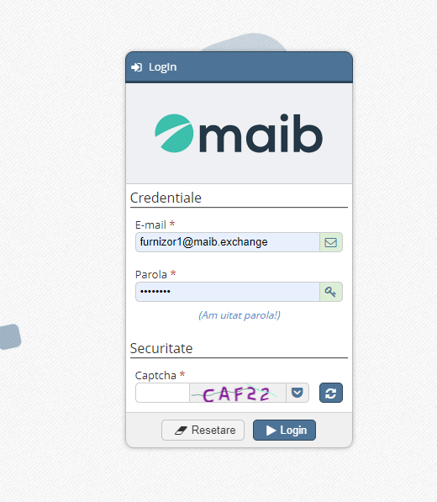
I. Logging in / registering in the eProcurement platform :
Step 1: insert the supplier's email address
Step 2: Initial password received by email ( eProcurement account creation )
Step 3
Step 4

Slide 3
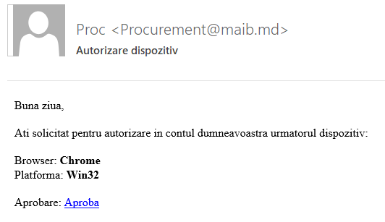
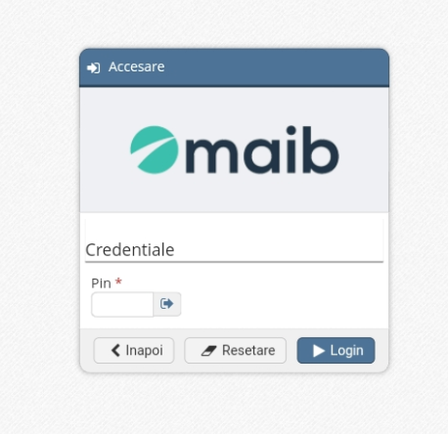
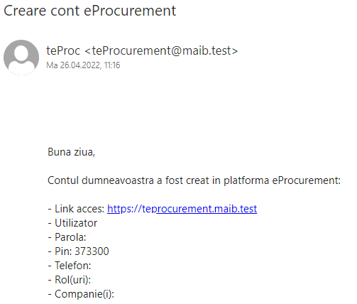
Step 5 . Press approval
Step 6 . After pressing " Approve " it will open:
Step 7 . The pin will be inserted received by email upon creation account in eProcurement

Slide 4
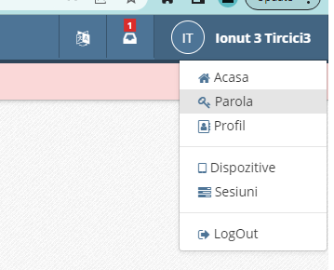
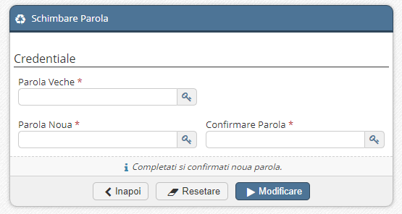
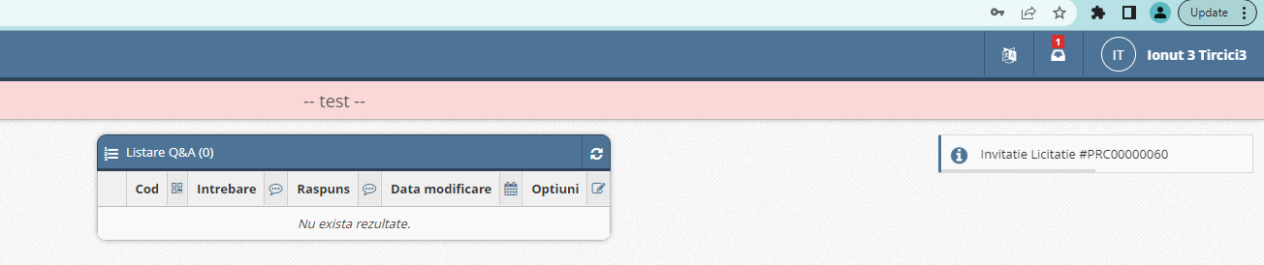
Step 7 . After logging in, the provider will set a different password than the one sent by the system .
Click on the name of the supplier
Click on the password
The new password is set
To save the new password .
Step 8 : In the upper right, the notifications regarding the auctions appear

Slide 5
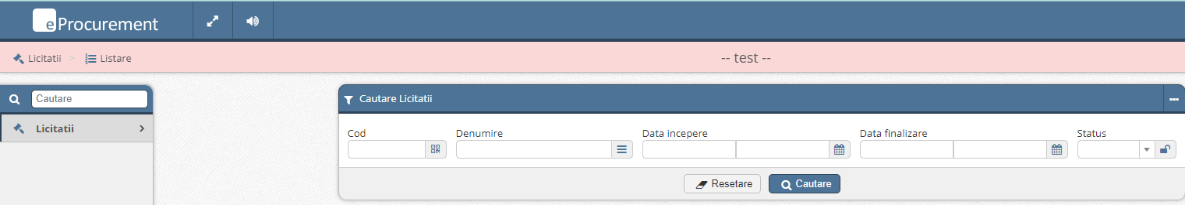
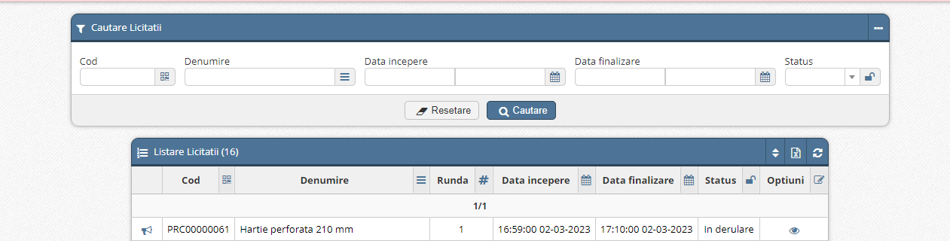
Step 9. visualization _ tenders _
Step 10: the auction/auctions in progress will open on the screen
Step 11: View Auction

Slide 6
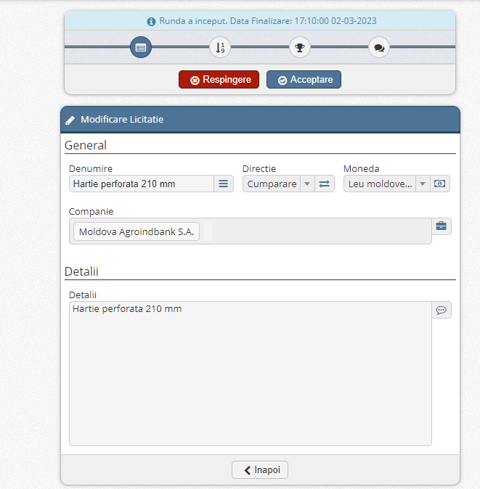
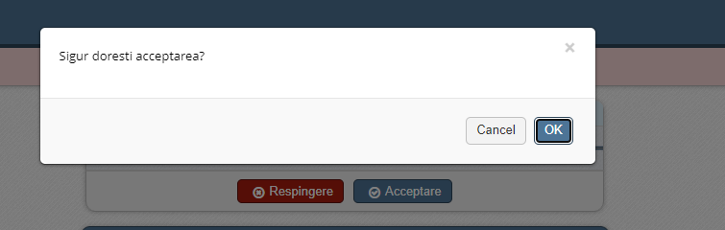
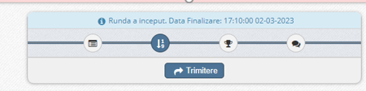
Step 12: Accept or reject participation in the auction
Camp explanations :
Questionnaire
Tender template - Documentation
Box for asking questions and providing clarifying answers
General tender data
rounds

Slide 7
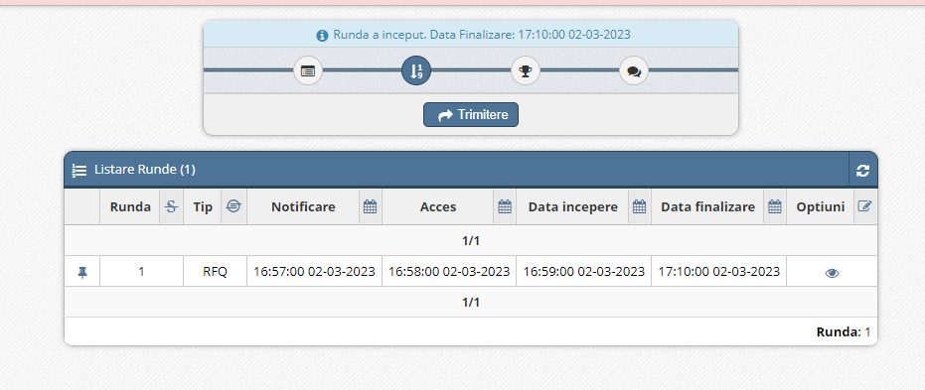
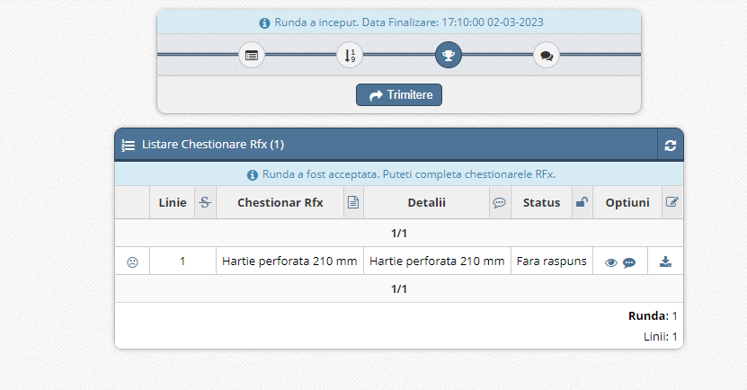
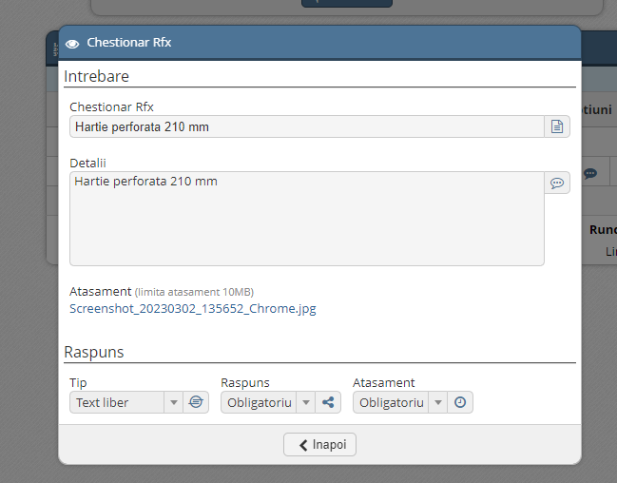
Step 13: View Auction Data
Deadline for submitting the offer
Step 14: When accessing the "questionnaire" menu, the form for submitting the offer will open
Step 15: The Organizer's attachment: technical requirements, specifications will be downloaded

Slide 8
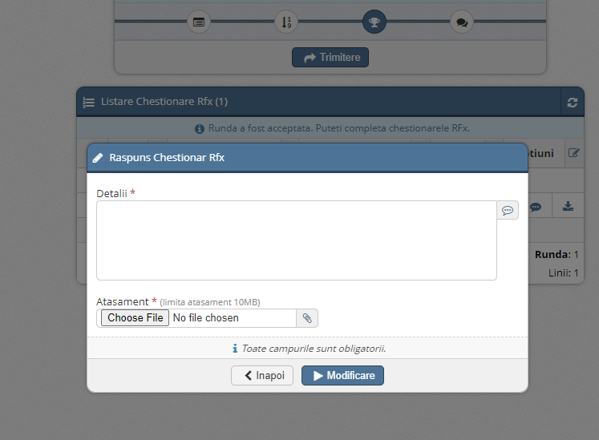
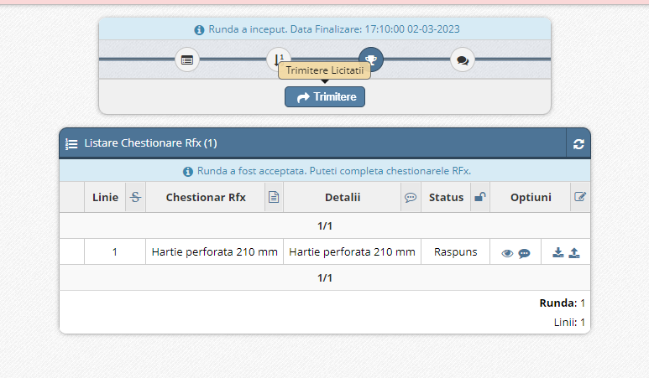
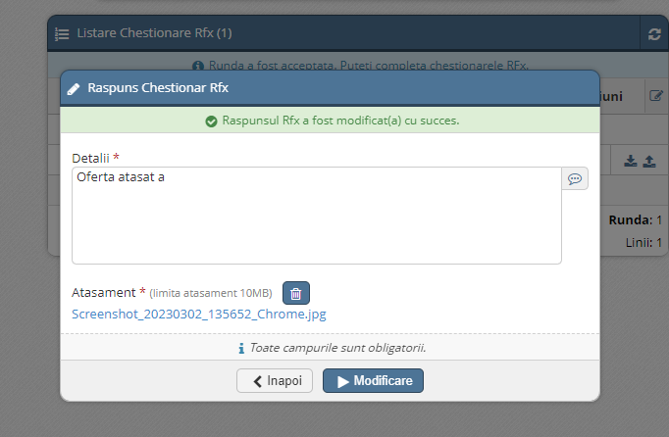
Step 16: By accessing this icon, it will open:
Step 17: After attaching, press change
Step 18 (Final) :
After the green message appears, press the Back button .

